Slide 1
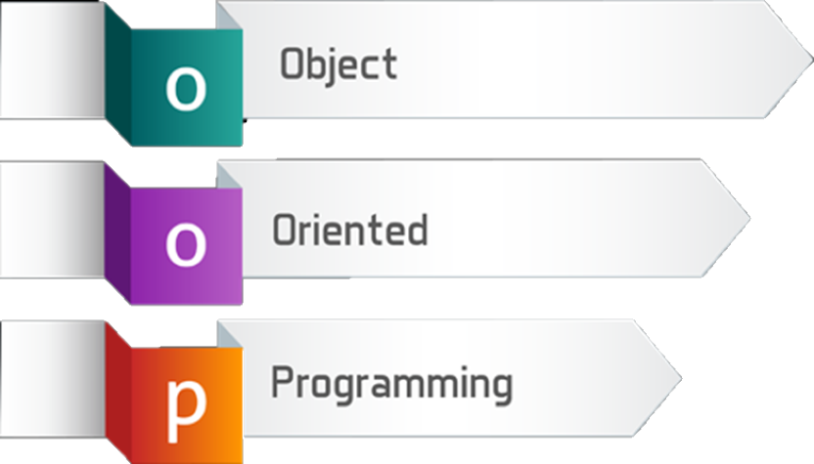
Defining Classes
Classes, Fields, Constructors, Properties, Methods
SoftUni Team
Technical Trainers
Software University
http://softuni.bg

Slide 2
Table of Contents
Abstract Data Types
Defining Simple Classes
Fields
Properties
Methods
Constructors

Slide 3
Have a Question?
sli.do
#fund-csharp

Slide 4

Abstract Data Type
Hide Details from the Client

Slide 5
Abstract Data Type
Data type whose representation is hidden from the client
string ADT – indexed sequence of chars:
string()
int Length()
char CharAt(int index)
boolean IsEmpty()
// many others…
ADTs are defined by their usage

Slide 6


Abstract Data Type (2)
You don't need to know the implementation to use an ADT
Dog:
Dog()
string Name()
void Bark()
void Sleep()
Computer:
Computer()
void TurnOn()
void TurnOff()
string Spec()

Slide 7

Defining Classes
Creating Class for an ADT

Slide 8
Defining Simple Classes
Class is a concrete implementation of an ADT
Classes provide structure for describing and creating objects
Keyword
Class name
class Dice
{
…
}
Class body

Slide 9


Naming Classes
Name classes with nouns using PascalCasing
Use descriptive nouns
Avoid abbreviations (except widely known, e.g. URL, HTTP, etc.)
class Dice { … }
class BankAccount { … }
class TPMF { … }
class bankaccount { … }
class intcalc { … }

Slide 10
Class Members
Class is made up of state and behavior
Fields store state
Methods describe behaviour
class Dice
{
int sides;
string type;
void Roll(){ … }
}
class Dog
{
int age;
string type;
void Bark(){ … }
}
Fields
Fields
Method
Method

Slide 11

Creating an Object
A class can have many instances (objects)
class Program
{
public static void Main()
{
Dice diceD6 = new Dice();
Dice diceD8 = new Dice();
}
}
Use the new keyword
Variable stores a reference

Slide 12
Object Reference
Declaring a variable creates a reference in the stack
The new keyword allocates memory on the heap
Dice diceD6 = new Dice();
STACK
HEAP
obj
diceD6
(1540e19d)
type = null
sides = 0

Slide 13
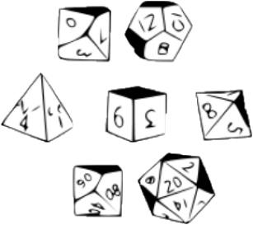

Classes vs. Objects
Classes provide structure for describing and creating objects
An object is a single instance of a class
Dice is…
Dice ADT
Dice (Class)
D6 Dice (Object)

Slide 14
Classes vs. Objects
Classes provide structure for creating objects
An object is a single instance of a class
class
Dice
Object name
Class name
object diceD6
type: string
sides: int
Class data
type = "six sided"
sides = 6
Roll(…)
Class actions
Object data

Slide 15

Class Data
Storing Data Inside a Class

Slide 16
Fields and Modifiers
Class fields have type and name
Classes and class members have modifiers that define visibility
public class Dice
{
private string type;
private int sides;
private int[] rollFrequency;
private Person owner;
public void Roll () { … }
}
Class modifier
Fields should always be private
Fields can be of any type

Slide 17
Properties
Used to create accessors and mutators (getters and setters)
public class Dice
{
private int sides;
public int Sides
{
public get { return this.sides; }
public set { this.sides = value; }
}
}
The field is hidden
The getter provides access to the field
The setter provides field change

Slide 18
Problem: Car
Create a class Car
private string make;
private string model;
private int year
public string Make
{
get { return this.make; }
set { this.make = value; }
}
//TODO: Balance and Year Getter & Setter
Car
-make:string
-model:string
-year:int
(no actions)

Slide 19

Methods
Defining a Class Behaviour

Slide 20
Methods
Store executable code (algorithm) that manipulate state
public class Dice
{
private int sides;
private Random rnd = new Random();
public int Roll() {
int rollResult = rnd.Next(1, this.sides + 1);
return rollResult;
}
}
this points to the current instance

Slide 21

Problem: Car Extension
Create a class Car
Car
-make:string
-model:string
-year:int
-fuelQuantity:double
-fuelConsumption:double
+Drive(double distance):void
+WhoAmI():string

Slide 22
Solution: Car Extension
//TODO Get the other fields from previous problem
private double fuelQuantity;
private double fuelConsumption;
//TODO Get the other properties from previous problem
public double FuelQuantity{
get { return this.fuelQuantity; }
set { this.fuelQuantity = value; }}
public double FuelConsumption{
get { return this.fuelConsumption; }
set { this.fuelConsumption = value; }}
Check your solution here: https://judge.softuni.bg/Contests/1478/Defining-Classes-Lab

Slide 23
Solution: Car Extension (2)
public void Drive(double distance)
{
bool canContinue = this.FuelQuantity – (distance * this.FuelConsumption) >= 0;
if(canContionue)
this.FuelQuantity -= distance * this.FuelConsumption;
else
Console.WriteLine("Not enough fuel to perform this trip!");
}
Check your solution here: https://judge.softuni.bg/Contests/1478/Defining-Classes-Lab

Slide 24
Solution: Car Extension (3)
public string WhoAmI()
{
StringBuilder sb = new StringBuilder();
sb.AppendLine($"Make: {this.Make}");
sb.AppendLine($"Model: {this.Model}");
sb.AppendLine($"Year: {this.Year}");
sb.Append($"Fuel: {this.FuelQuantity:F2}L");
return sb.ToString();
}
Check your solution here: https://judge.softuni.bg/Contests/1478/Defining-Classes-Lab

Slide 25

Constructors
Object Initialization

Slide 26
Constructors
Special methods, executed during object creation
The only one way to call a constructor in C# is through the keyword new
public class Dice
{
private int sides;
public Dice() {
this.sides = 6;
}
}
Overloading default constructor

Slide 27
Object Initial State
Constructors set object's initial state
public class Dice
{
int sides;
int[] rollFrequency;
public Dice(int sides) {
this.sides = sides;
this.rollFrequency = new int[sides];
}
}
Always ensure correct state

Slide 28
Multiple Constructors
You can have multiple constructors in the same class
public class Dice
{
private int sides;
public Dice() { }
public Dice(int sides)
{
this.sides = sides;
}
}
Constructor without parameters
Constructor with parameters

Slide 29
Constructor Chaining
Constructors can call each other
public class Person {
private string name;
private int age;
public Person() {
this.age = 18;
}
public Person(string name) : this() {
this.name = name;
}
}
Calls default constructor

Slide 30
Problem: Car Constructors
Extend the previous problem and create 3 constructors
Default values are:
Make – VW
Model – Golf
Year – 2025
FuelQuantity = 200
FuelConsumption = 10
Car
+Car()
+Car(string make, string model, int year)
+Car(string make, string model, int year, double fuelQuantity, double fuelConsumption)

Slide 31
Solution: Car Constructors
public Car() {
this.Make = "VW";
this.Model = "Golf";
this.Year = 2025;
this.FuelQuantity = 200;
this.FuelConsumption = 10;}
public Car(string make, string model, int year) : this() {
this.Make = make;
this.Model = model;
this.Year = year;}
Check your solution here: https://judge.softuni.bg/Contests/1478/Defining-Classes-Lab

Slide 32
Problem: Car Constructors(2)
public Car(string make, string model, int year, double fuelQuantity, double fuelConsumption)
: this(make, model, year)
{
this.FuelQuantity = fuelQuantity;
this.FuelConsumption = fuelConsumption;
}
Check your solution here: https://judge.softuni.bg/Contests/1478/Defining-Classes-Lab

Slide 33
Problem: Car Engine And Tires
Create the two classes and extend the Car class
Engine
Tire
-horsePower:int
-cubicCapacity:double
-horsePower:int
-cubicCapacity:double
+Engine(int horsePower, double cubicCapacity)
+Engine(int horsePower, double cubicCapacity)
Car
+Car(string make, string model, int year, double fuelQuantity, double fuelConsumption, Engine engine, Tire[] tires)

Slide 34
Solution: Car Engine And Tires
private int horsePower;
private double cubicCapacity;
public Engine(int horsePower, double cubicCapacity){
this.HorsePower = horsePower;
this.CubicCapacity = cubicCapacity;}
public int HorsePower {
get { return this.horsePower; }
set { this.horsePower = value; } }
public double CubicCapacity{
get { return this.cubicCapacity; }
set { this.cubicCapacity = value; }}
Check your solution here: https://judge.softuni.bg/Contests/1478/Defining-Classes-Lab

Slide 35
Solution: Car Engine And Tires(2)
private int year;
private double pressure;
public Tire(int year, double pressure){
this.Year = year;
this.Pressure = pressure;}
public int Year{
get { return this.year; }
set { this.year = value; }}
public double Pressure{
get { return this.pressure; }
set { this.pressure = value; }}
Check your solution here: https://judge.softuni.bg/Contests/1478/Defining-Classes-Lab

Slide 36
Solution: Car Engine And Tires(3)
public Car(string make, string model, int year, double fuelQuantity, double fuelConsumption, Engine engine, Tire[] tires)
: this(make, model, year, fuelQuantity, fuelConsumption)
{
this.Engine = engine;
this.Tires = tires;
}
Check your solution here: https://judge.softuni.bg/Contests/1478/Defining-Classes-Lab

Slide 37

Summary
…
…
…
Classes define structure for objects
Objects are instances of a class
Classes define fields, methods, constructors and other members
Constructors:
Invoked when creating new instances
Initialize the object's state

Slide 38
https://softuni.bg/trainings/courses

Slide 39












SoftUni Diamond Partners

Slide 40




SoftUni Organizational Partners

Slide 41




Trainings @ Software University (SoftUni)
Software University – High-Quality Education and Employment Opportunities
softuni.bg
Software University Foundation
http://softuni.foundation/
Software University @ Facebook
facebook.com/SoftwareUniversity
Software University Forums
forum.softuni.bg

Slide 42

License
This course (slides, examples, demos, videos, homework, etc.) is licensed under the "Creative Commons Attribution-NonCommercial-ShareAlike 4.0 International" license

